Slide 1
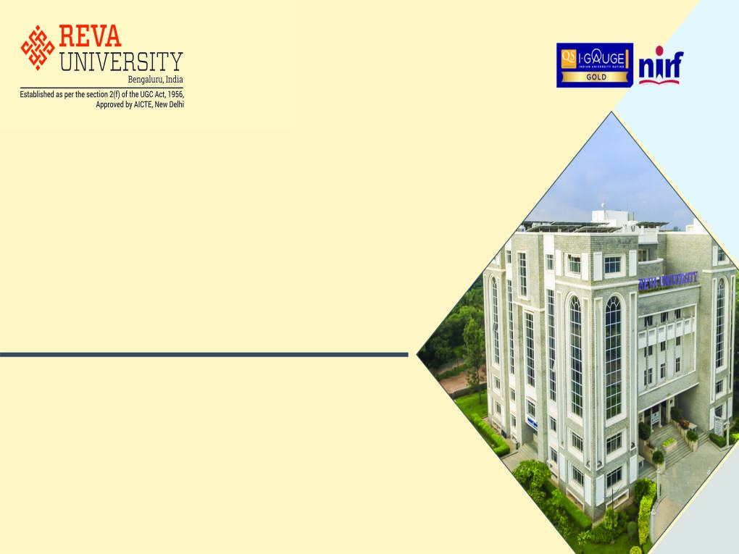
School of Computing and Information Technology
Course Delivery
B.Tech - VI Semester
VIRTUALIZATION AND CLOUD COMPUTING
(BTCS15F6200)
By
Prof. Kiran M
Assistant Professor
kiranm@reva.edu.in

Slide 2
Contents
Syllabus
Unit - 2:
Cloud Computing Technologies
Cloud Infrastructure Mechanisms

Slide 3
Syllabus
UNIT | SYLLABUS | WEIGHTAGE
1 | Introduction to Cloud Computing: Origins and Influences; Basic Concepts and Terminology; Goals and Benefits; Risks and Challenges. Fundamental Concepts and Models: Roles and Boundaries; Cloud Characteristics; Cloud Delivery Models; Cloud Deployment Models. | 25 Marks
2 | Cloud Computing Technologies: Broadband Networks and Internet Architecture; Data Center Technology; Virtualization Technology; Web Technology; Multitenant Technology; Service Technology; Case study. Cloud Infrastructure Mechanisms: Logical Network Perimeter; Virtual Server; Cloud Storage Device; Cloud Usage Monitor; Resource Replication; Ready-made Environment. | 25 Marks
3 | Specialized Cloud Mechanisms: Automated Scaling Listener; Load Balancer; SLA Monitor; Pay-per-use Monitor; Audit Monitor; Failover System; Hypervisor; Resource cluster; Multi-device Broker; State Management. Cloud Management Mechanisms: Remote Administration System; Resource Management System; SLA Management System; Billing Management System. | 25 Marks
4 | Virtualization: Implementation levels of virtualization; Virtualization structures/tools and mechanisms; Virtualization of CPU; Memory and I/O devices. | 25 Marks

Slide 4
VIRTUALIZATION AND CLOUD COMPUTING
(BTCS15F6200)
UNIT - 2
Cloud Computing Technologies
Cloud Infrastructure Mechanisms

Slide 5
Cloud Computing Technologies
Cloud-Enabling Technologies:
Modern-day clouds are strengthened by a set of primary technology components that collectively enable key features and characteristics associated with modern-day cloud computing.
The following such technologies are covered in this section:
Broadband Networks and Internet Architecture
Data Center Technology
Virtualization Technology
Web Technology
Multitenant Technology
Service Technology

Slide 6
Cloud Computing Technologies (Contd..)
Broadband Networks and Internet Architecture:
All clouds must be connected to a network.
– This inevitable/unavoidable requirement forms an essential dependency on internetworking.
Internetworks, or the Internet, allow for the remote provisioning of IT resources and are directly supportive of ubiquitous network access.
The potential of cloud platforms therefore generally grows in parallel with advancements in Internet connectivity and service quality.
Internet Service Providers (ISPs):
Established and deployed by ISPs, the Internet’s largest backbone networks are strategically interconnected by core routers that connect the world’s multinational networks.

Slide 7
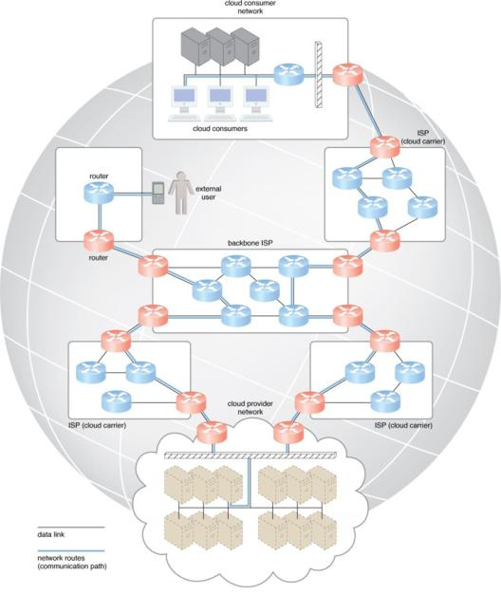
Cloud Computing Technologies (Contd..)
An ISP network interconnects to other ISP networks and various organizations.
Messages travel over dynamic network routes in this ISP internetworking configuration.

Slide 8
Cloud Computing Technologies (Contd..)
The concept of the Internet was based on a decentralized/distributed provisioning and management model.
ISPs can freely deploy, operate, and manage their networks in addition to selecting partner ISPs for interconnection.
Internet Corporation for Assigned Names and Numbers (ICANN) supervise and coordinate Internet communications.
Governmental and regulatory laws order the service provisioning conditions for organizations and ISPs both within and outside of national borders.
Worldwide connectivity is enabled through a hierarchical topology composed of Tiers 1, 2, and 3.

Slide 9
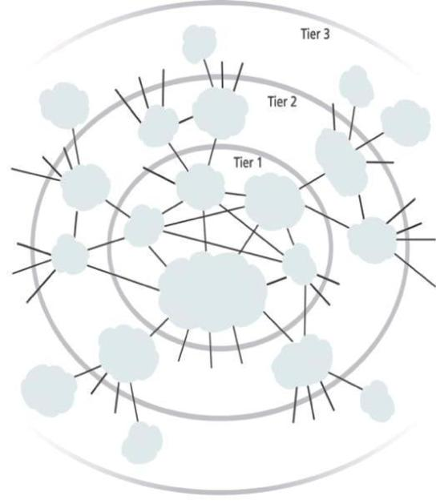
Cloud Computing Technologies (Contd..)
An generalization of the internetworking structure of the Internet.

Slide 10
Cloud Computing Technologies (Contd..)
The core Tier 1 is made of large-scale, international cloud providers that oversee massive interconnected global networks, which are connected to Tier 2’s large regional providers.
The interconnected ISPs of Tier 2 connect with Tier 1 providers, as well as the local ISPs of Tier 3.
Cloud consumers and cloud providers can connect directly using a Tier 1 provider, since any operational ISP can enable Internet connection.
Two fundamental components used to construct the internetworking architecture are:
Connectionless Packet Switching (Datagram Networks)
Router-Based Interconnectivity

Slide 11
Cloud Computing Technologies (Contd..)
Connectionless Packet Switching (Datagram Networks):
End-to-End (sender-receiver pair) data flows are divided into packets of a limited size that are received and processed through network switches and routers, then queued and forwarded from one intermediary node to the next.
Each packet carries the necessary location information, such as the Internet Protocol (IP) or Media Access Control (MAC) address, to be processed and routed at every source, intermediary, and destination node.
Router-Based Interconnectivity:
A router is a device that is connected to multiple networks through which it forwards packets.
Routers manage network traffic and maintains the network topology information that locates the next node on the communication path between the source and destination nodes.

Slide 12
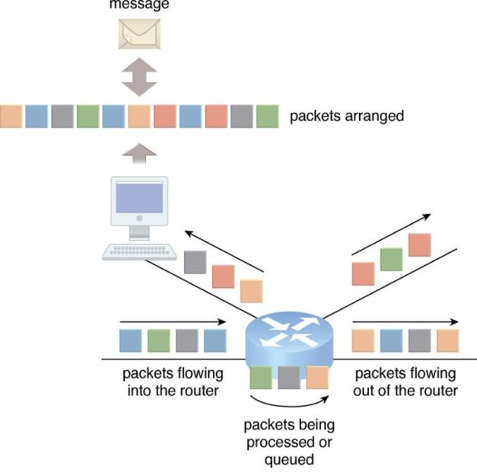
Cloud Computing Technologies (Contd..)
Packets traveling through the Internet are directed by a router that arranges them into a message.

Slide 13
Cloud Computing Technologies (Contd..)
The communication path that connects a cloud consumer with its cloud provider may involve multiple ISP networks.
This applies to ISPs that implement the Internet’s internetworking layer and interact with other network technologies, as follows:
Physical Network:
IP packets are transmitted through underlying physical networks that connect adjacent nodes, such as Ethernet, ATM network and so on.
Physical networks comprise a data link layer that controls data transfer between neighboring nodes, and a physical layer that transmits data bits through both wired and wireless media.

Slide 14
Cloud Computing Technologies (Contd..)
Transport Layer Protocol:
IP Transport layer protocols, such as the Transmission Control Protocol (TCP) and User Datagram Protocol (UDP), use the IP to provide standardized, end-to-end communication support that facilitates the navigation of data packets across the Internet.
Application Layer Protocol:
Protocols such as HTTP, SMTP for e-mail, BitTorrent for P2P, use transport layer protocols to standardize and enable specific data packet transferring methods over the Internet.
Many other protocols also fulfill application-centric requirements and use either TCP/IP or UDP as their primary method of data transferring across the Internet and LANs.

Slide 15
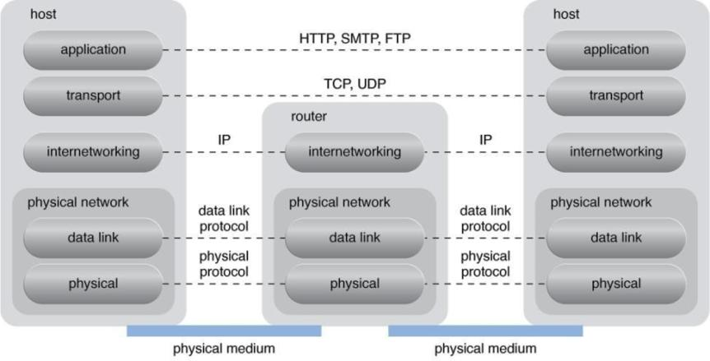
Cloud Computing Technologies (Contd..)
A generic view of the Internet reference model and protocol stack

Slide 16
Cloud Computing Technologies (Contd..)
Technical and Business Considerations:
Connectivity Issues:
In traditional, on-premise deployment models, enterprise applications and various IT solutions are commonly hosted on centralized servers and storage devices residing in the organization’s own data center.
End-user devices, such as smartphones and laptops, access the data center through the corporate network, which provides uninterrupted Internet connectivity.
TCP/IP facilitates both Internet access and on-premise data exchange over LANs.

Slide 17
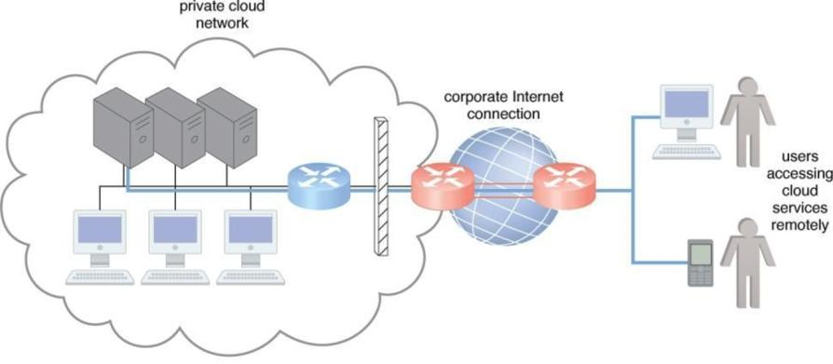
Cloud Computing Technologies (Contd..)
The internetworking architecture of a private cloud.
The physical IT resources that constitute the cloud are located and managed within the organization.

Slide 18
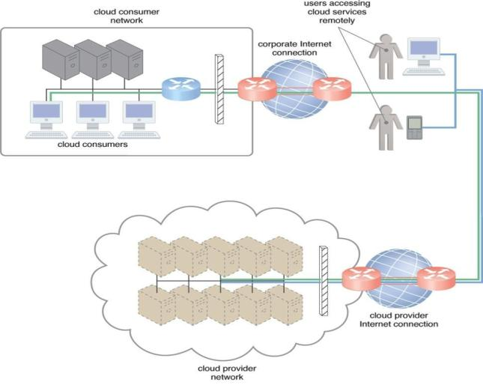
Cloud Computing Technologies (Contd..)
The internetworking architecture of an Internet-based cloud deployment model.
The Internet is the connecting agent between non-proximate cloud consumers, roaming end-users, and the cloud provider’s own network.

Slide 19
Cloud Computing Technologies (Contd..)
A comparison of on-premise and cloud-based internetworking.
On-Premise IT Resources | Cloud-Based IT Resources
internal end-user devices access corporate IT services through the corporate network | internal end-user devices access corporate IT services through an Internet connection
internal users access corporate IT services through the corporate Internet connection while roaming in external networks | internal users access corporate IT services while roaming in external networks through the cloud provider’s Internet connection
external users access corporate IT services through the corporate Internet connection | external users access corporate IT services through the cloud provider’s Internet connection

Slide 20
Cloud Computing Technologies (Contd..)
Network Bandwidth and Latency Issues:
Latency is the amount of time it takes a packet to travel from one data node to another.
Latency increases with every intermediary node on the data packet’s path.
IT solutions need to be assessed against business requirements that are affected by network bandwidth and latency, which are inherent to cloud interconnection.
Cloud Carrier and Cloud Provider Selection:
The service levels of Internet connections between cloud consumers and cloud providers are determined by their ISPs, which are usually different and therefore include multiple ISP networks in their paths.
QoS management across multiple ISPs is difficult to achieve in practice, requiring collaboration of the cloud carriers on both sides to ensure that their end-to-end service levels are sufficient for business requirements.

Slide 21
Cloud Computing Technologies (Contd..)
Data Center Technology:
Grouping IT resources in close proximity with one another, rather than having them geographically dispersed, allows for power sharing, higher efficiency in shared IT resource usage, and improved accessibility for IT personnel.
– These are the advantages that naturally popularized the data center concept.
Modern data centers exist as specialized IT infrastructure used to house centralized IT resources, such as servers, databases, networking and telecommunication devices, and software systems.

Slide 22
Cloud Computing Technologies (Contd..)
Data centers are typically comprised of the following technologies and components:
Virtualization:
Data centers consist of both physical and virtualized IT resources.
The physical IT resource layer refers to the facility infrastructure that houses computing/networking systems and equipment, together with hardware systems and their operating systems.
The resource abstraction and control of the virtualization layer is comprised of operational and management tools that are often based on virtualization platforms that abstract the physical computing and networking IT resources as virtualized components that are easier to allocate, operate, release, monitor, and control.

Slide 23
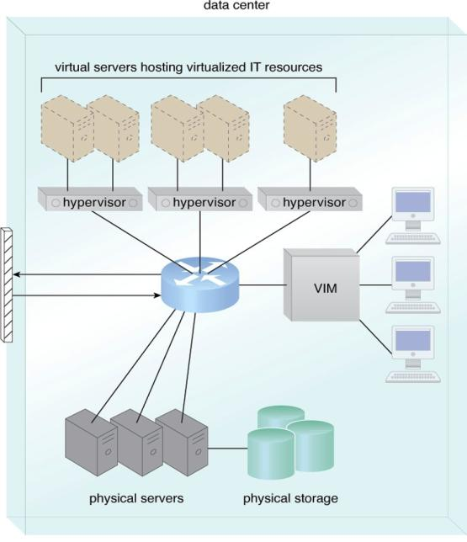
Cloud Computing Technologies (Contd..)
The common components of a data center working together to provide virtualized IT resources supported by physical IT resources.

Slide 24
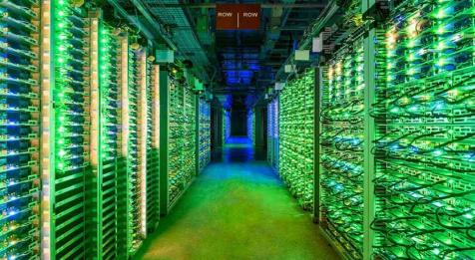

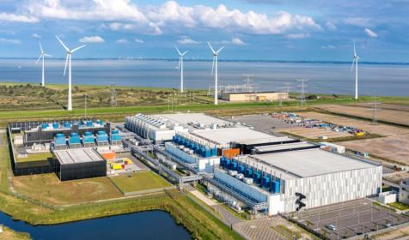
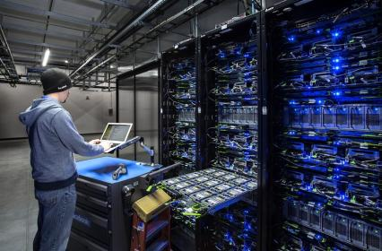
Cloud Computing Technologies (Contd..)

Slide 25
Cloud Computing Technologies (Contd..)
Standardization and Modularity:
Data centers are built upon standardized commodity hardware and designed with modular architectures.
– Aggregating multiple identical building blocks of facility infrastructure and equipment to support scalability, growth, and speedy hardware replacements.
Modularity and Standardization are key requirements for reduced investment and operational costs as they enable economies of scale for the procurement, deployment, operation, and maintenance processes.
Consolidated IT resources can serve different systems and be shared among different cloud consumers.

Slide 26
Cloud Computing Technologies (Contd..)
Automation:
Data centers have specialized platforms that automate tasks like provisioning, configuration, patching, and monitoring without supervision.
Advances in data center management platforms and tools influence autonomic computing technologies to enable self-configuration and self-recovery.
Remote Operation and Management:
Most of the operational and administrative tasks of IT resources in data centers are commanded through the network’s remote consoles and management systems.
Technical personnel are not required to visit the dedicated rooms that house servers, except to perform highly specific tasks, such as equipment handling and cabling or hardware-level installation and maintenance.

Slide 27
Cloud Computing Technologies (Contd..)
High Availability:
Since any form of data center significantly impacts business continuity for the organizations that use their services.
Data centers are designed to operate with increasingly higher levels of redundancy to sustain availability.
Data centers usually have redundant, uninterruptable power supplies, cabling, and environmental control subsystems in anticipation of system failure, along with communication links and clustered hardware for load balancing.
Security-Aware Design, Operation, and Management:
Requirements for security, such as physical and logical access controls and data recovery strategies, need to be thorough and comprehensive for data centers.
– Since they are centralized structures that store and process business data.

Slide 28
Cloud Computing Technologies (Contd..)
Facilities:
Data center facilities are custom-designed locations that are outfitted with specialized computing, storage, and network equipments.
These facilities have several functional layout areas, as well as various power supplies, cabling, and environmental control stations that regulate heating, ventilation, air conditioning, fire protection, and other related subsystems.

Slide 29
Cloud Computing Technologies (Contd..)
Computing Hardware:
Much of the heavy processing in data centers is often executed by standardized commodity servers that have substantial computing power and storage capacity.
Several computing hardware technologies are integrated into these modular servers, such as:
rackmount form factor server design composed of standardized racks with interconnects for power, network, and internal cooling.
support for different hardware processing architectures, such as x86-32 bits, x86-64 bits, and RISC.
power-efficient multi-core CPU architecture that houses hundreds of processing cores in a space as small as a single unit of standardized racks.
redundant and hot-swappable components, such as hard disks, power supplies, network interfaces, and storage controller cards.

Slide 30
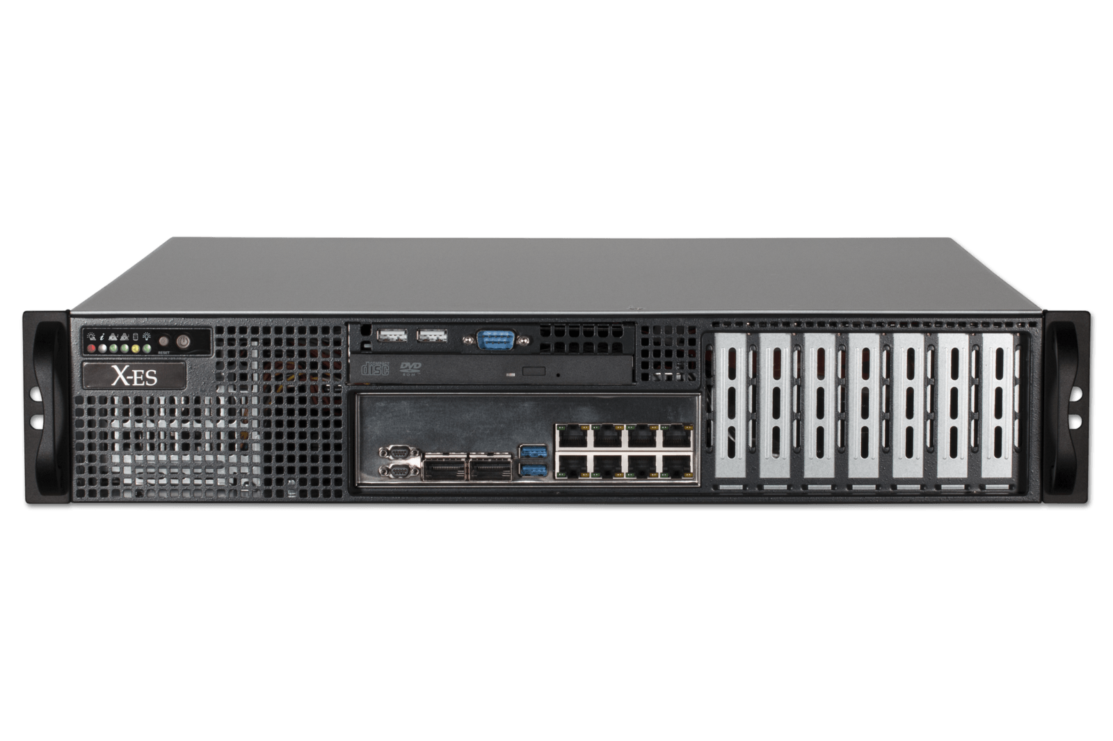
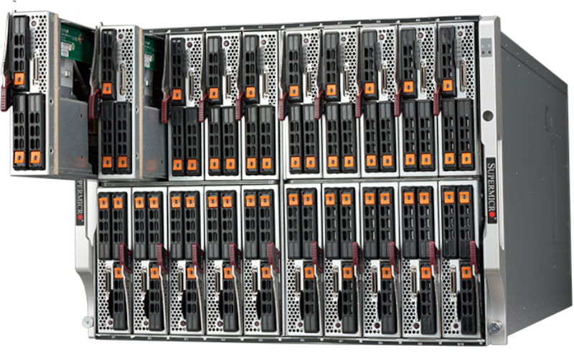
Cloud Computing Technologies (Contd..)
Computing architectures such as blade server technologies use rack-embedded physical interconnections (blade enclosures), fabrics (switches), and shared power supply units and cooling fans.
The interconnections enhance intercomponent networking and management while optimizing physical space and power.
These systems typically support individual server hot-swapping, scaling, replacement, and maintenance, which benefits the deployment of fault-tolerant systems that are based on computer clusters.
Rackmount Server
Blade Server

Slide 31
Cloud Computing Technologies (Contd..)
Storage Hardware:
Data centers have specialized storage systems that maintain enormous amounts of digital information in order to fulfill considerable storage capacity needs.
These storage systems are containers housing numerous hard disks that are organized into arrays.
Storage systems usually involve the following technologies:
Hard Disk Arrays – These arrays inherently divide and replicate data among multiple physical drives, and increase performance and redundancy by including spare disks.
– This technology is often implemented using Redundant Arrays of Independent Disks (RAID) schemes, which are typically realized through hardware disk array controllers.

Slide 32
Cloud Computing Technologies (Contd..)
I/O Caching – This is generally performed through hard disk array controllers, which enhance disk access times and performance by data caching.
Hot-Swappable Hard Disks – These can be safely removed from arrays without requiring prior powering down.
Storage Virtualization – This is realized through the use of virtualized hard disks and storage sharing.
Fast Data Replication Mechanisms – These include snapshotting, which is saving a virtual machine’s memory into a hypervisor-readable file for future reloading, and volume cloning, which is copying virtual or physical hard disk volumes and partitions.

Slide 33
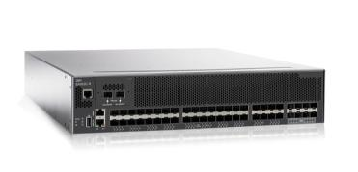
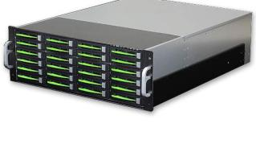
Cloud Computing Technologies (Contd..)
Networked storage devices usually fall into one of the following categories:
Storage Area Network (SAN) – Physical data storage media are connected through a dedicated network and provide block-level data storage access using industry standard protocols, such as the Small Computer System Interface (SCSI).
Network-Attached Storage (NAS) – Hard drive arrays are contained and managed by this dedicated device, which connects through a network and facilitates access to data using file-centric data access protocols like the Network File System (NFS) or Server Message Block (SMB).

Slide 34
Cloud Computing Technologies (Contd..)
Network Hardware:
Data centers require extensive network hardware in order to enable multiple levels of connectivity.
For a simplified version of networking infrastructure, the data center is broken down into five network subsystems.
Carrier and External Networks Interconnection:
A subsystem related to the internetworking infrastructure.
This interconnection is usually comprised of backbone routers that provide routing between external WAN connections and the data center’s LAN, as well as perimeter network security devices such as firewalls and VPN gateways.

Slide 35
Cloud Computing Technologies (Contd..)
Web-Tier Load Balancing and Acceleration:
This subsystem comprises Web acceleration devices, such as XML preprocessors, encryption/decryption appliances, and layer 7 switching devices that perform content-aware routing.
LAN Fabric:
The LAN fabric constitutes the internal LAN and provides high-performance and redundant connectivity for all of the data center’s network-enabled IT resources.
It is often implemented with multiple network switches that facilitate network communications and operate at speeds of up to ten gigabits per second.
These advanced network switches can also perform several virtualization functions, such as LAN segregation into VLANs, link aggregation, controlled routing between networks, load balancing, and failover.

Slide 36
Cloud Computing Technologies (Contd..)
SAN Fabric:
Related to the implementation of Storage Area Networks (SANs) that provide connectivity between servers and storage systems.
The SAN fabric is usually implemented with Fibre Channel (FC), Fibre Channel over Ethernet (FCoE), and InfiniBand network switches.
NAS Gateways:
This subsystem supplies attachment points for NAS-based storage devices and implements protocol conversion hardware that facilitates data transmission between SAN and NAS devices.

Slide 37
Cloud Computing Technologies (Contd..)
Virtualization Technology:
Virtualization is the process of converting a physical IT resource into a virtual IT resource.
Most types of IT resources can be virtualized, including:
Servers – A physical server can be abstracted into a virtual server.
Storage – A physical storage device can be abstracted into a virtual storage device or a virtual disk.
Network – Physical routers and switches can be abstracted into logical network fabrics, such as VLANs.
Power – A physical UPS and power distribution units can be abstracted into what are commonly referred to as virtual UPSs.

Slide 38
Cloud Computing Technologies (Contd..)
This section focuses on the creation and deployment of virtual servers through server virtualization technology.
The first step in creating a new virtual server through virtualization software is the allocation of physical IT resources, followed by the installation of an operating system.
Virtual servers use their own guest operating systems, which are independent of the operating system (Host OS) in which they were created.
Both the guest operating system and the application software running on the virtual server are unaware of the virtualization process.
– meaning these virtualized IT resources are installed and executed as if they were running on a separate physical server.
This uniformity of execution that allows programs to run on physical systems as they would on virtual systems is a vital characteristic of virtualization.

Slide 39
Cloud Computing Technologies (Contd..)
Virtualization software runs on a physical server called a host or physical host, whose underlying hardware is made accessible by the virtualization software.
The virtualization software functionality involves system services that are specifically related to Virtual Machine Management and not normally found on standard operating systems.
This is why this software is sometimes referred to as a Virtual Machine Manager or a Virtual Machine Monitor (VMM), but most commonly known as a Hypervisor.

Slide 40
Cloud Computing Technologies (Contd..)
Hardware Independence:
The installation of an operating system’s configuration and application software in a unique IT hardware platform results in many software-hardware dependencies.
In a non-virtualized environment, the operating system is configured for specific hardware models and requires reconfiguration if these IT resources need to be modified.
Virtualization is a conversion process that translates unique IT hardware into emulated and standardized software-based copies.
Through hardware independence, virtual servers can easily be moved to another virtualization host, automatically resolving multiple hardware-software incompatibility issues.
As a result, cloning and manipulating virtual IT resources is much easier than duplicating physical hardware.

Slide 41
Cloud Computing Technologies (Contd..)
Server Consolidation:
The coordination function that is provided by the virtualization software allows multiple virtual servers to be simultaneously created in the same virtualization host.
Virtualization technology enables different virtual servers to share one physical server.
This process is called Server Consolidation.
It is commonly used to increase hardware utilization, load balancing, and optimization of available IT resources. The resulting flexibility is such that different virtual servers can run different guest operating systems on the same host.
This fundamental capability directly supports common cloud characteristics, such as on-demand usage, resource pooling, elasticity, scalability, and resiliency.

Slide 42
Cloud Computing Technologies (Contd..)
Resource Replication:
The Virtual servers are created as Virtual Disk Images that contain binary file copies of hard disk content.
These virtual disk images are accessible to the host’s operating system, meaning simple file operations, such as copy, move, and paste, can be used to replicate, migrate, and back up the virtual server.
This ease of manipulation and replication is one of the most prominent features of virtualization technology as it enables:
The creation of standardized virtual machine images commonly configured to include virtual hardware capabilities, guest operating systems, and additional application software, for pre-packaging in virtual disk images in support of instantaneous deployment.
Increased capability in the migration and deployment of a virtual machine’s new instances by being able to rapidly scale out and up.

Slide 43
Cloud Computing Technologies (Contd..)
The ability to roll back, which is the instantaneous creation of VM Snapshots by saving the state of the virtual server’s memory and hard disk image to a host-based file.
– (Operators can easily revert to these snapshots and restore the virtual machine to its prior state.)
The support of business continuity with efficient backup and restoration procedures, as well as the creation of multiple instances of critical IT resources and applications.

Slide 44
Cloud Computing Technologies (Contd..)
Operating System-Based Virtualization:
Operating system-based virtualization is the installation of virtualization software in a pre-existing operating system, which is called the host operating system.
Virtualization software translates hardware IT resources that require unique software for operation into virtualized IT resources that are compatible with a range of operating systems.
Since the host operating system is a complete operating system in itself, many operating system-based services that are available as administration tools can be used to manage the physical host.
Examples of such services include:
Backup and Recovery
Integration to Directory Services
Security Management

Slide 45
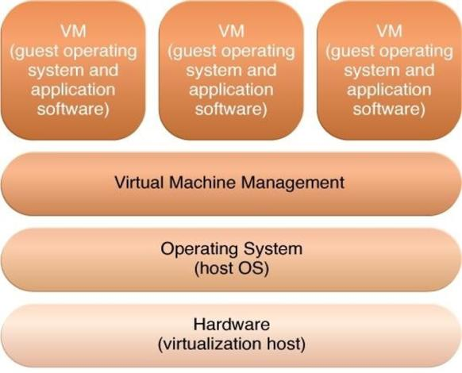
Cloud Computing Technologies (Contd..)
The different logical layers of operating system-based virtualization, in which the VM is first installed into a full host operating system and subsequently used to generate virtual machines.

Slide 46
Cloud Computing Technologies (Contd..)
Operating system-based virtualization can introduce demands and issues related to performance overhead such as:
The host operating system consumes CPU, memory, and other hardware IT resources.
Hardware-related calls from guest operating systems need to traverse several layers to and from the hardware, which decreases overall performance.
Licenses are usually required for host operating systems, in addition to individual licenses for each of their guest operating systems.
A concern with operating system-based virtualization is the processing overhead required to run the virtualization software and host operating systems.

Slide 47
Cloud Computing Technologies (Contd..)
Hardware-Based Virtualization:
Hardware-based virtualization represents the installation of virtualization software directly on the physical host hardware so as to bypass the host operating system.
Allowing the virtual servers to interact with hardware without requiring intermediary action from the host operating system generally makes hardware-based virtualization more efficient.
Virtualization software is typically referred to as a hypervisor for this type of processing.
A hypervisor has a simple user-interface that requires a negligible amount of storage space.
It exists as a thin layer of software that handles hardware management functions to establish a virtualization management layer.

Slide 48
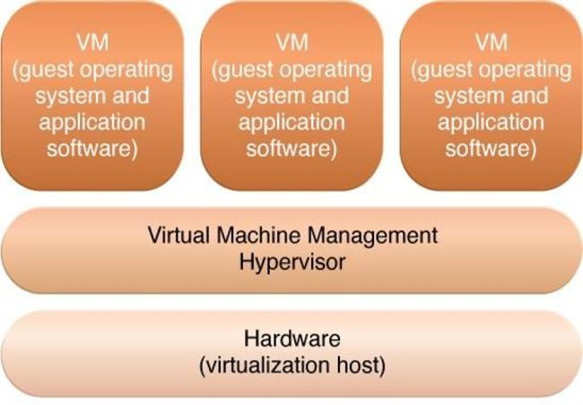
Cloud Computing Technologies (Contd..)
The different logical layers of hardware-based virtualization, which does not require another host operating system.

Slide 49
Cloud Computing Technologies (Contd..)
One of the main issues of hardware-based virtualization concerns compatibility with hardware devices.
The virtualization layer is designed to communicate directly with the host hardware, meaning all of the associated device drivers and support software need to be compatible with the hypervisor.
Hardware device drivers may not be as available to hypervisor platforms as they are to operating systems.
Host management and administration features may further not include the range of advanced functions that are common to operating systems.

Slide 50
Cloud Computing Technologies (Contd..)
Virtualization Management:
Many administrative tasks can be performed more easily using virtual servers as opposed to using their physical counterparts.
Modern virtualization software / hypervisor provides several advanced management functions that can automate administration tasks and reduce the overall operational burden on virtualized IT resources.
Virtualized IT resource management is often supported by Virtualization Infrastructure Management (VIM) tools that collectively manage virtual IT resources and rely on a centralized management module, otherwise known as a controller, that runs on a dedicated computer.
VIMs are commonly incorporated by the Resource Management System (RMS) mechanism.

Slide 51
Cloud Computing Technologies (Contd..)
Other Considerations:
Performance Overhead:
Virtualization may not be ideal for complex systems that have high workloads with little use for resource sharing and replication.
A poorly formulated virtualization plan can result in excessive performance overhead.
A common strategy used to rectify the overhead issue is a technique called para-virtualization.
– represents a software interface to the virtual machines that is not identical to that of the underlying hardware.
A major drawback of this approach is the need to adapt the guest operating system to the para-virtualization API, which can impair the use of standard guest operating systems while decreasing solution portability.

Slide 52
Cloud Computing Technologies (Contd..)
Special Hardware Compatibility:
Many hardware vendors that distribute specialized hardware may not have device driver versions that are compatible with virtualization software.
Conversely, the software itself may be incompatible with recently released hardware versions.
These types of incompatibility issues can be resolved using established commodity hardware platforms and mature virtualization software products.
Portability:
The programmatic and management interfaces that establish administration environments for a virtualization program to operate with various virtualization solutions can introduce portability gaps due to incompatibilities.
Initiatives such as the Open Virtualization Format (OVF) for the standardization of virtual disk image formats are dedicated to improving this concern.

